Slide 1
Introduction to Dockers and Containers

Slide 2
Agenda
Evolution of Containers and Dockers
Overview of Docker
Installing Docker
Docker Registries and Images

Slide 3
Evolution of Containers & Dockers
1

Slide 4
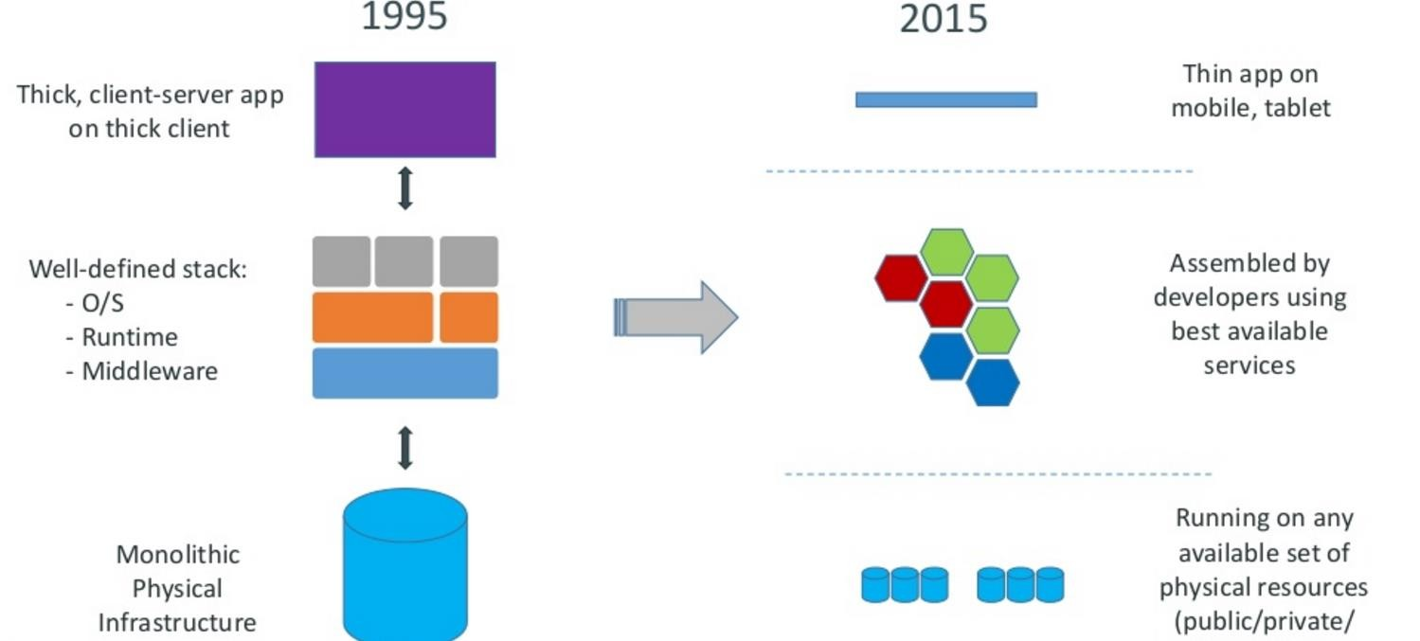
Monolithic Application Challenges
2

Slide 5
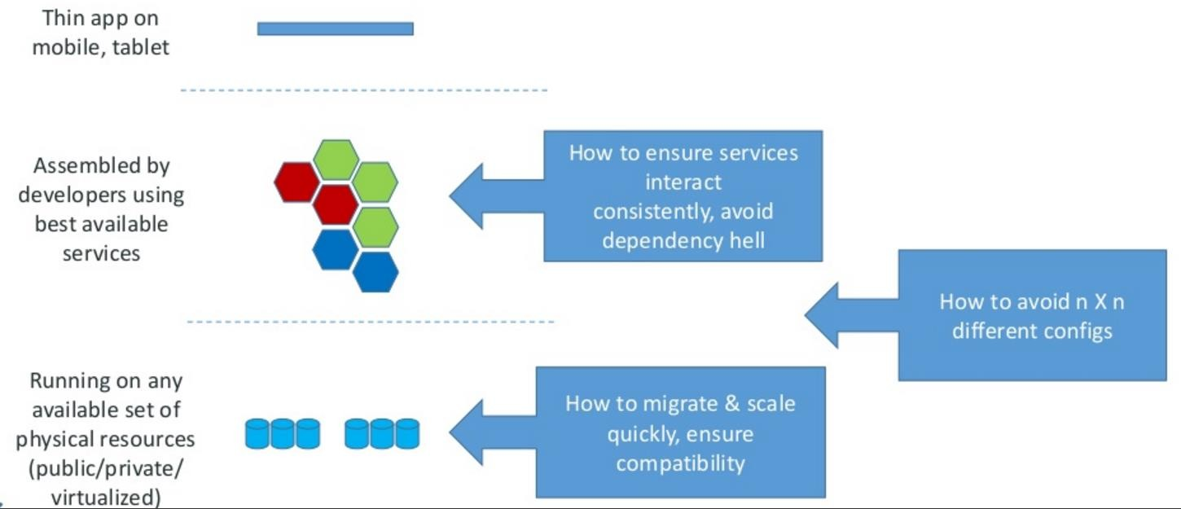
Monolithic Application Challenges
3

Slide 6
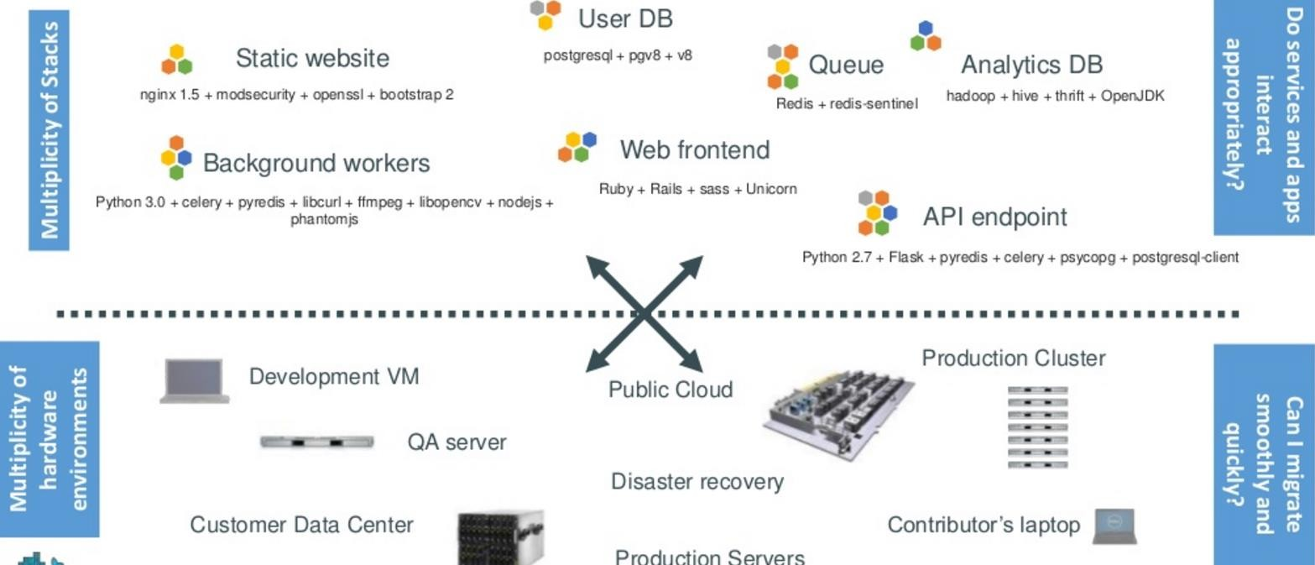
The challenge continued
4

Slide 7
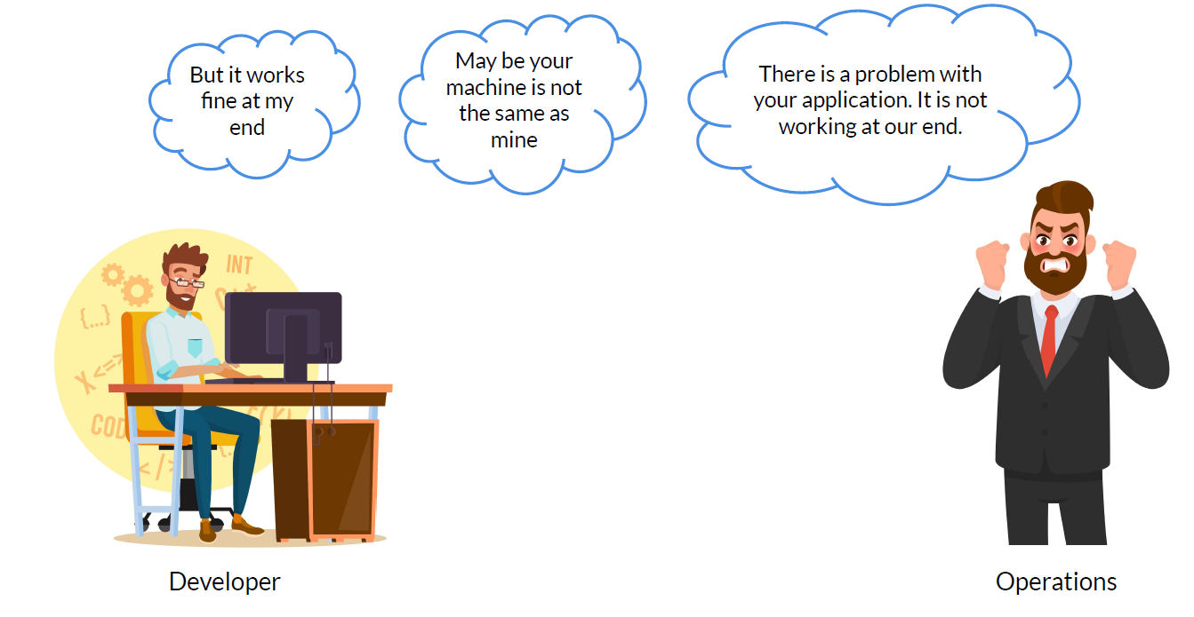
4

Slide 8
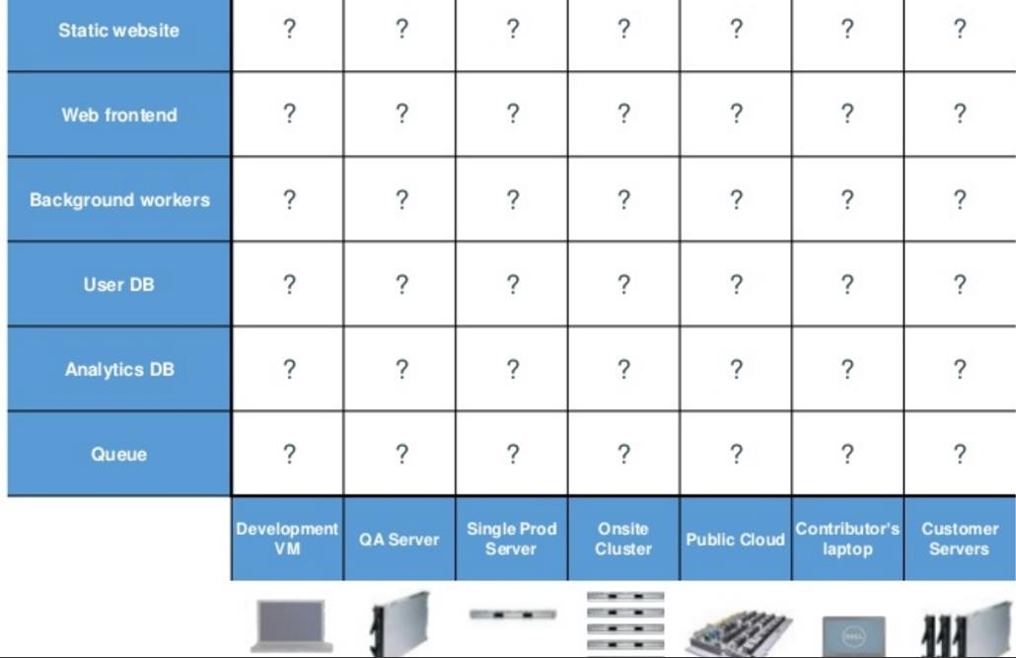
Looking for all kinds of solutions…
5

Slide 9
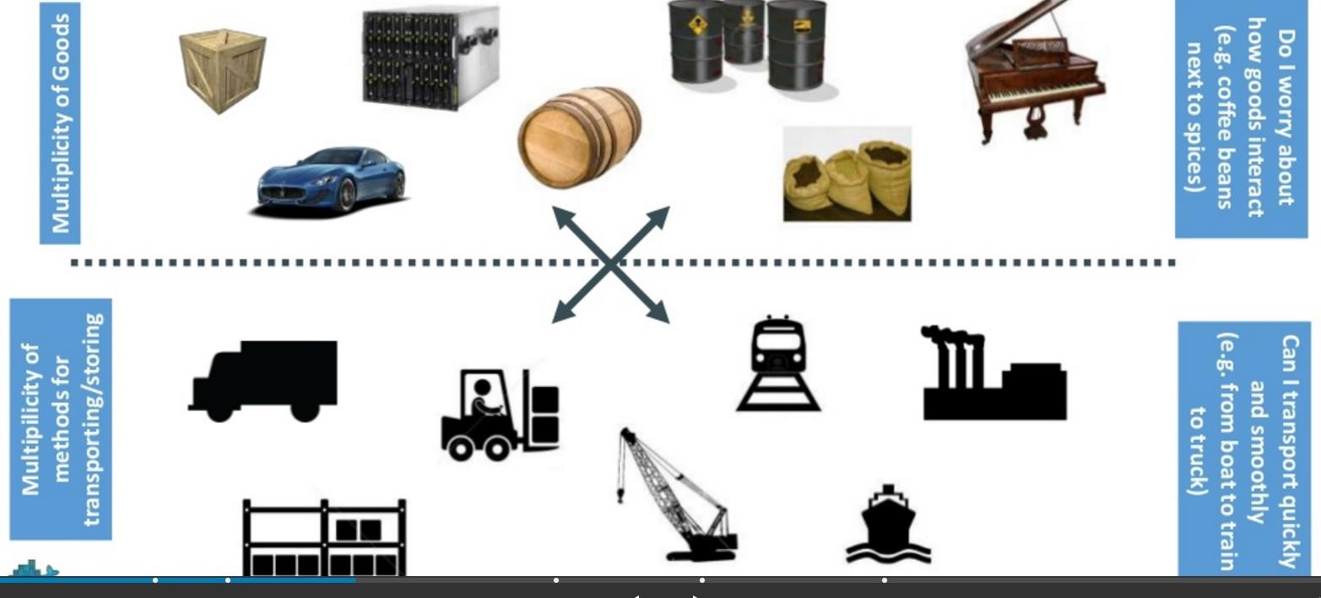
Challenges with Cargo Transport Company
6

Slide 10
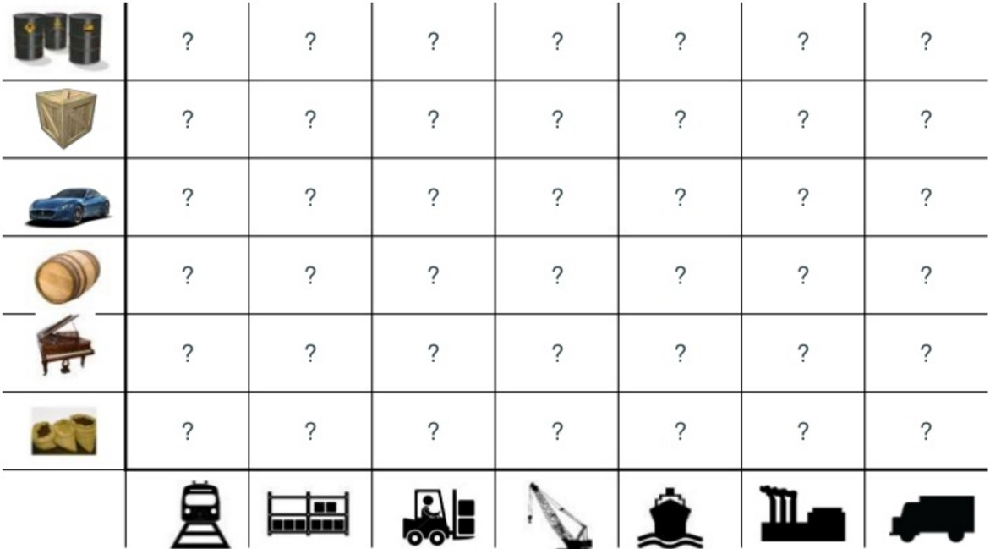
What are the possibilities
7

Slide 11
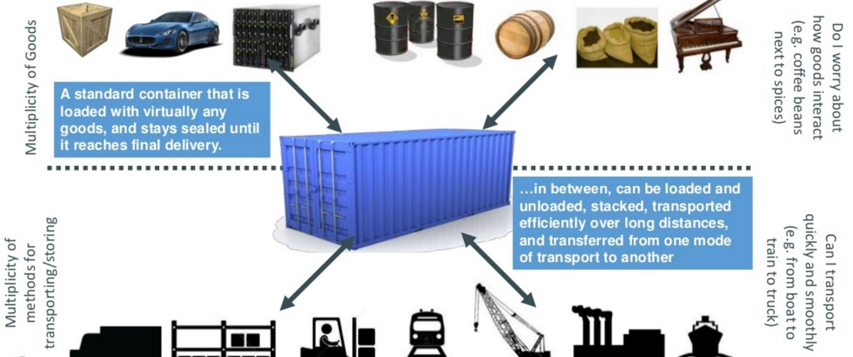
SOLUTION—Shipping containers
8

Slide 12
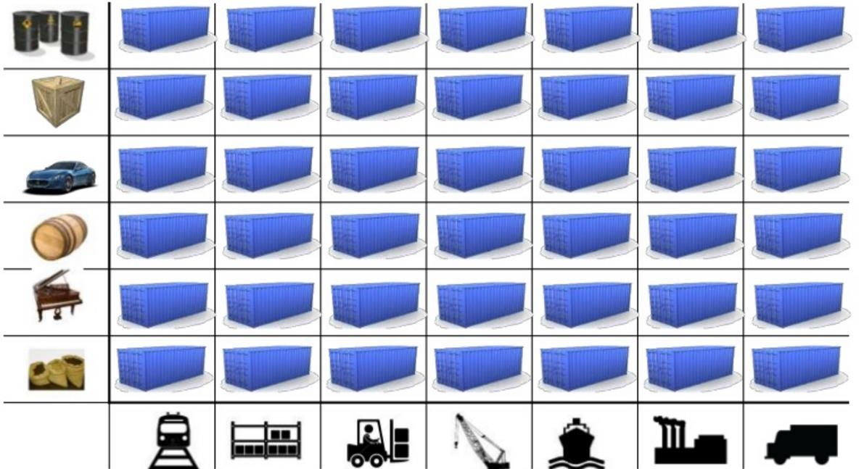
This solved the problem
9

Slide 13
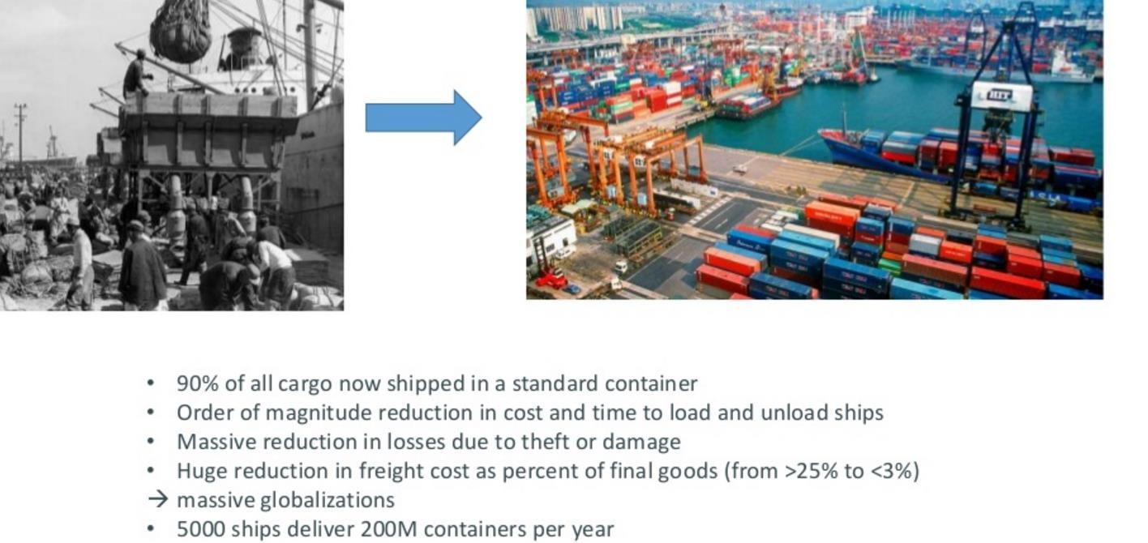
Today shipping is done with containers
10

Slide 14
How does this container idea translate to Enterprise Application Problems

Slide 15
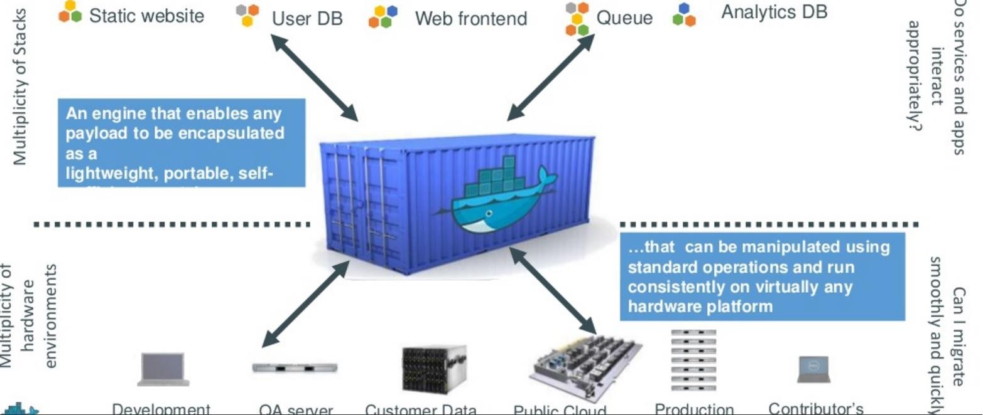
How does this container idea translate to Enterprise Application Problems
12

Slide 16
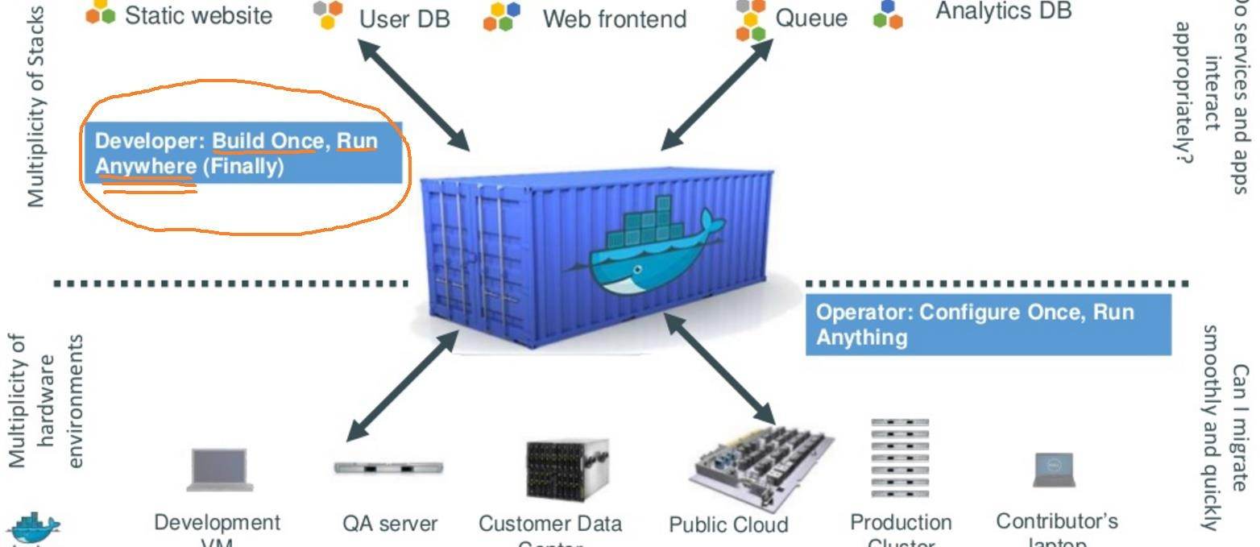
Do once run anywhere
13

Slide 17
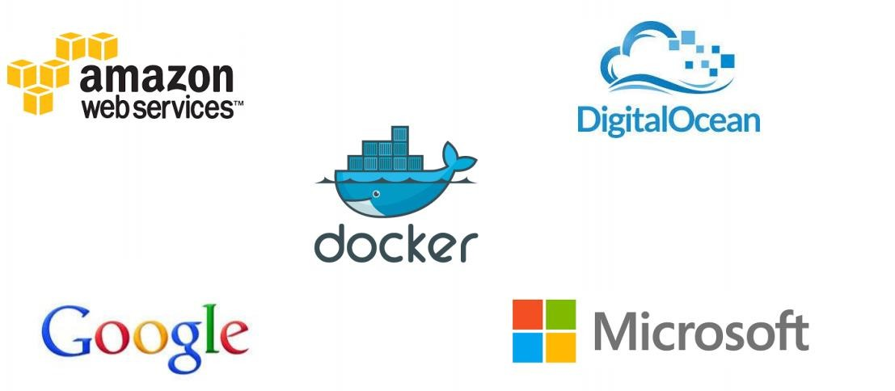
Docker is supported in many Cloud platforms
15

Slide 18
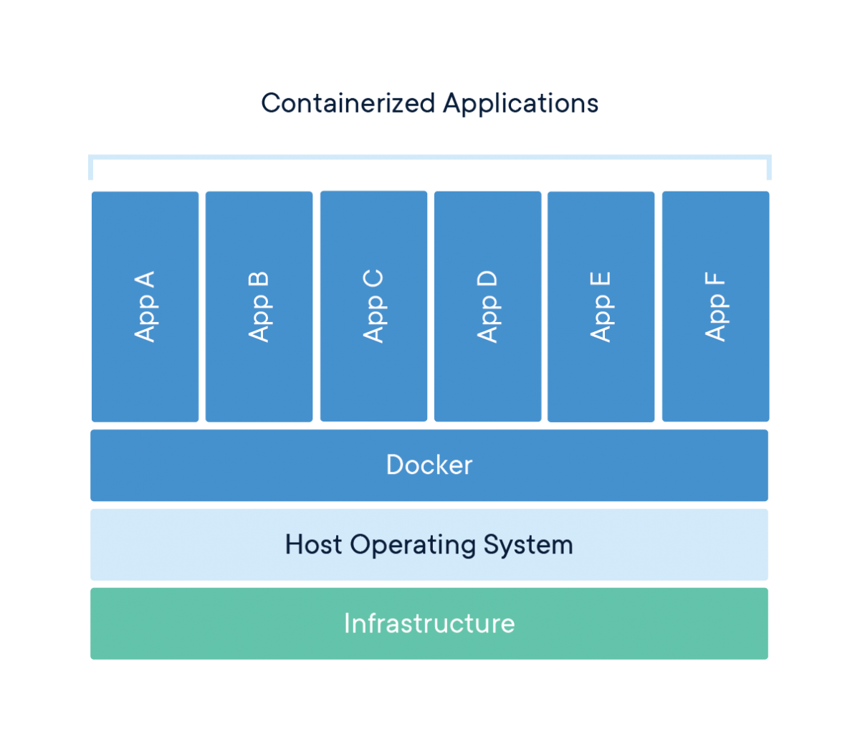
What is a Container?
15
A container is a standard unit of software that packages up code and all its dependencies so the application runs quickly and reliably from one computing environment to another.
A Docker container image is a lightweight, standalone, executable package of software that includes everything needed to run an application: code, runtime, system tools, system libraries and settings.
Container images become containers at runtime and in the case of Docker containers - images become containers when they run on Docker Engine

Slide 19
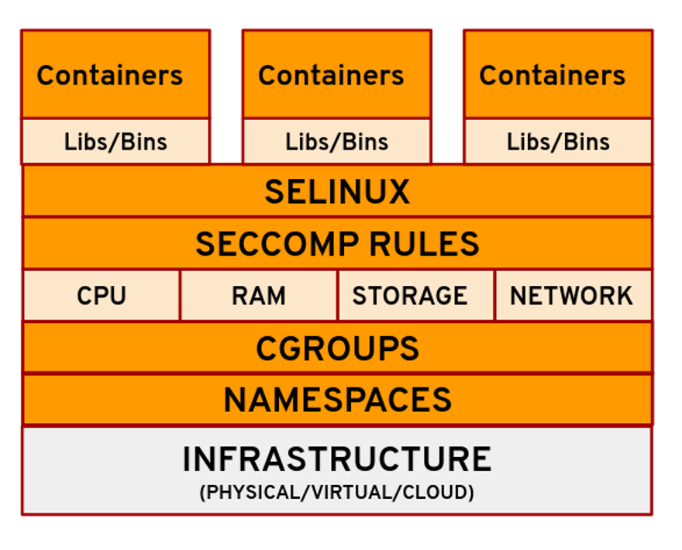
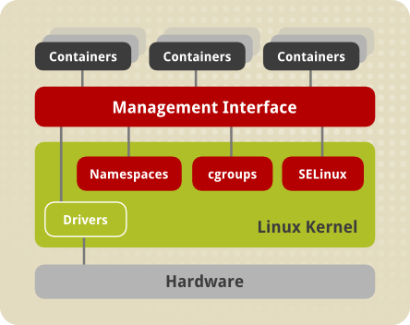
Container Building Blocks
A container is a standard unit of software that packages up code and all its with other containers, each running as isolated processes in user space.
https://access.redhat.com/documentation/en-us/red_hat_enterprise_linux_atomic_host/7/html/overview_of_containers_in_red_hat_systems/introduction_to_linux_containers
https://opensource.com/article/21/8/container-linux-technology

Slide 20
Namespaces
Technique where groups of processes are separated in such a way that they cannot see resources in other groups.
PID namespace provides a separate enumeration of process identifiers within each namespace.
6 namespaces: mnt, pid, net, ipc, uts, user
Ref:https://man7.org/linux/man-pages/man7/namespaces.7.html

Slide 21
Cgroups
Known as control groups
It can be used to restrict, prioritize and monitor the resource usage on the process level
Can be used to set limits on resource e.g. cpu, memory, disk I/O throughput and network bandwidth

Slide 22
Container Namespaces
Namespaces provide a layer of isolation for the containers by giving the container a view of what appears to be its own Linux filesystem. This limits what a process can see and therefore restricts the resources available to it.
Docker uses a technology called namespaces to provide the isolated workspace called the container. When you run a container, Docker creates a set of namespaces for that container. These namespaces provide a layer of isolation.
All the containers use the same user namespace and cgroup resource namespaces others running on the host

Slide 23
Finding Container Namespace

Slide 24
Access Container Namespaces

Slide 25
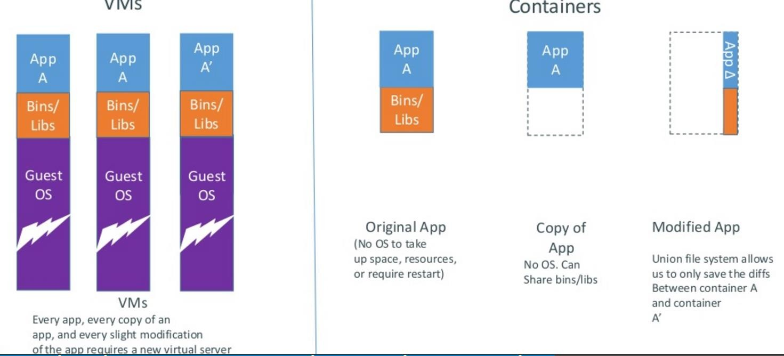
Docker containers are lightweight
19

Slide 26
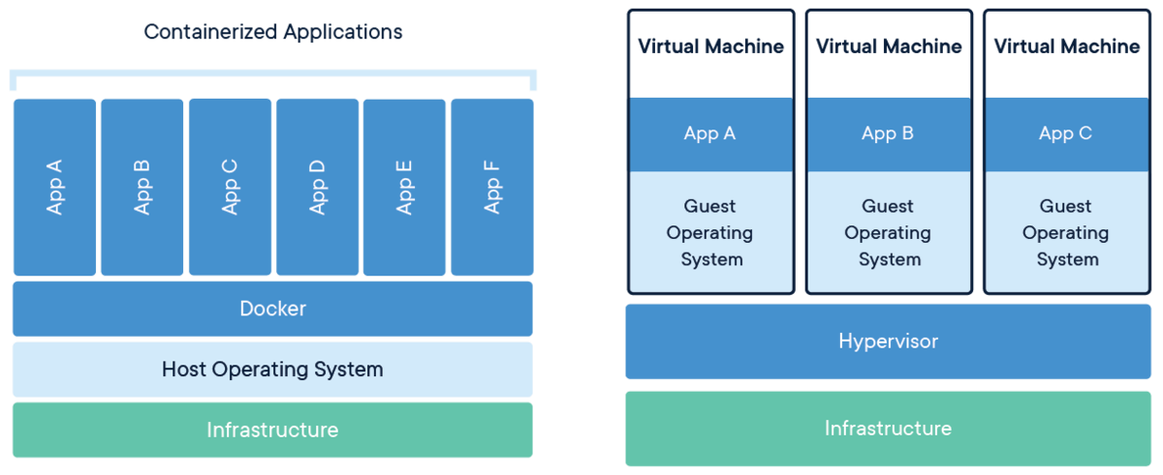
Containers and Virtual Machines Architecture
20

Slide 27
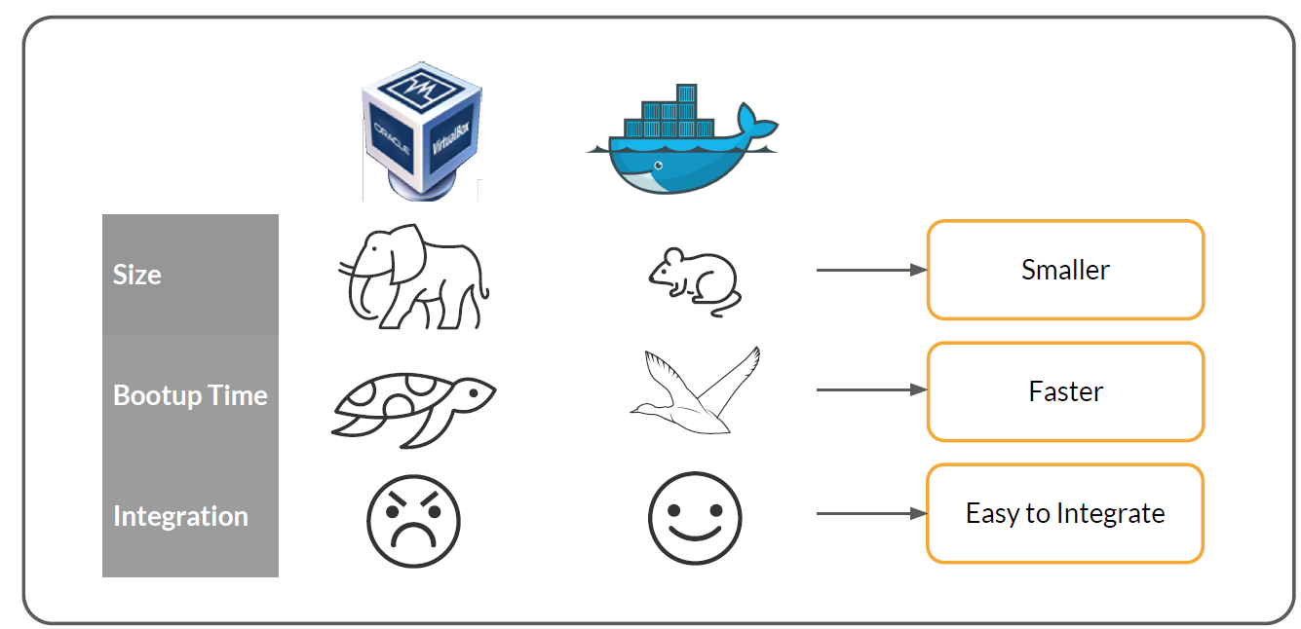
Differences between Containers and Virtual Machines
20

Slide 28
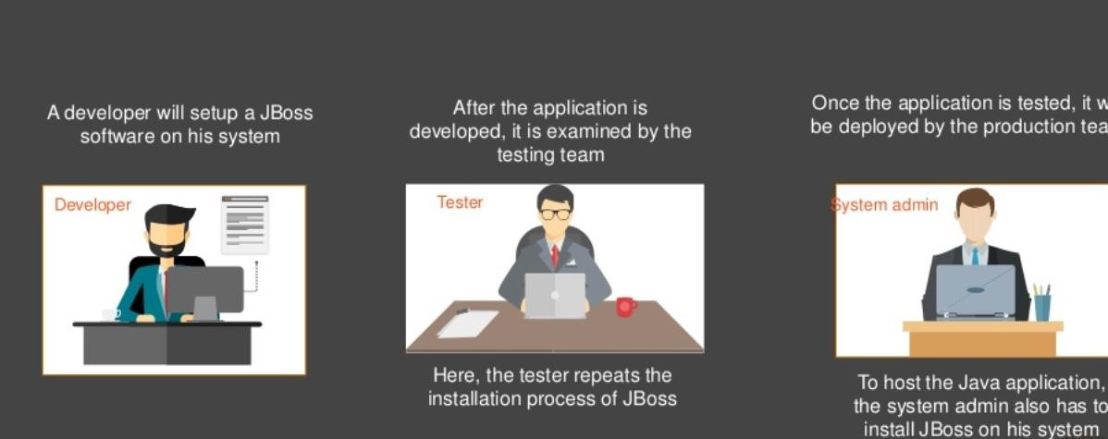
Use Case

Slide 29
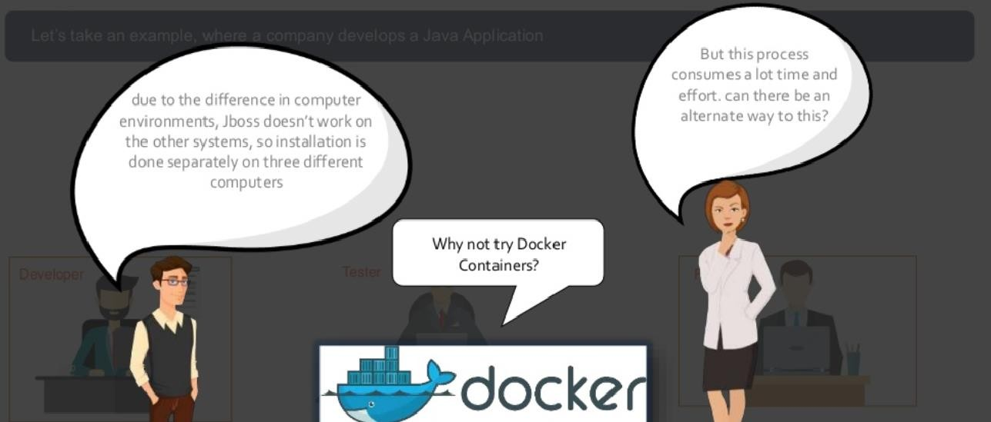
Use Case

Slide 30
Overview of Docker

Slide 31
What is Docker?
Docker is an open platform for developing, shipping, and running container applications.
Enables to separate applications from infrastructure so that software can be quickly delivered.
Docker’s methodologies for shipping, testing, and deploying code quickly significantly reduces the delay between writing code and running it in production.
Provides the ability to package and run an application in a loosely isolated environment called a container.

Slide 32
Benefits of Dockers
Fast, consistent delivery of your applications
Responsive deployment and scaling
Running more workloads on the same hardware

Slide 33
Docker Editions
Docker Community Edition (CE) (Free of cost) is ideal for individual developers and small teams looking to get started with Docker and experimenting with container based apps. Can only use Docker CLI
Docker Enterprise Edition ( is designed for enterprise development and IT teams who build, ship, and run business critical applications in production at scale.Supports both CLI and GUI.

Slide 34
Comparison of Docker Editions

Slide 35
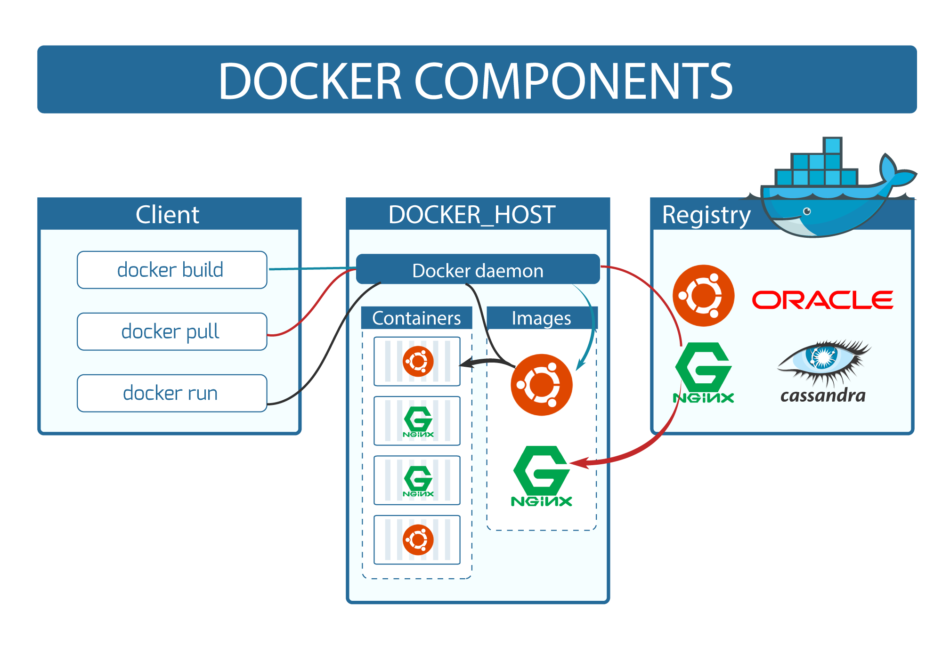
Docker Architecture & Components

Slide 36
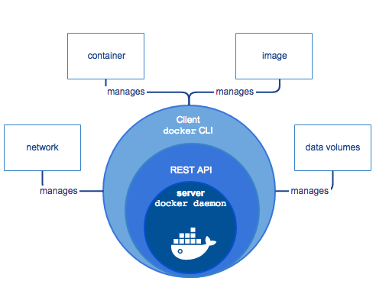
Docker Engine
Docker Engine is a client-server application with these major components:
A server which is a type of long-running program called a daemon process (the dockerd command).
A REST API which specifies interfaces that programs can use to talk to the daemon and instruct it what to do.
A command line interface (CLI) client (the docker command).
The CLI uses the Docker REST API to control or interact with the Docker daemon through scripting or direct CLI commands.
The daemon creates and manages Docker objects, such as images, containers, networks, and volumes.

Slide 37
Docker Components
The Docker daemon
The Docker daemon (dockerd) listens for Docker API requests and manages Docker objects such as images, containers, networks, and volumes.
The Docker client
The Docker client (docker) is the primary way that many Docker users interact with Docker.
When any commands such as docker run is executed, the client sends these commands to dockerd, which carries them out.
The docker command uses the Docker API.

Slide 38
Docker Registries
Docker registry stores Docker images. Docker Hub and Docker Cloud are public registries that anyone can use, and Docker is configured to look for images on Docker Hub by default.
Default Docker Registry is DockerHub in which both public and private repositories can be created
When docker pull is executed , the required images are pulled from configured registry.
When the docker push command is executed , image is pushed to the configured registry.

Slide 39
Docker Images
An image is a read-only template with instructions for creating a Docker container.
An image is based on another base OS image, with some additional customization.
For example –One may build an image which is based on the ubuntu image, but installs the Apache web server and your application, as well as the configuration details needed to make your application run.
Using Dockerfile own images are built. Each instruction in a Dockerfile creates a layer in the image. When any layers are changed in the Dockerfile and rebuild the image, only those layers which have changed are rebuilt. This is why images are lightweight, small, and faster , when compared to virtualization technologies.

Slide 40
Docker Containers
A container is a runnable instance of an image. One can create, start, stop, move, or delete a container using the Docker API or CLI.
Containers are lightweight because they don’t need the extra load of a hypervisor, but run directly within the host machine’s kernel
By default, a container is relatively well isolated from other containers and its host machine.
A container is defined by its image as well as any configuration options you provide to it when you create or start it.
When a container is removed, any changes to its state that are not stored in persistent storage disappear.

Slide 41
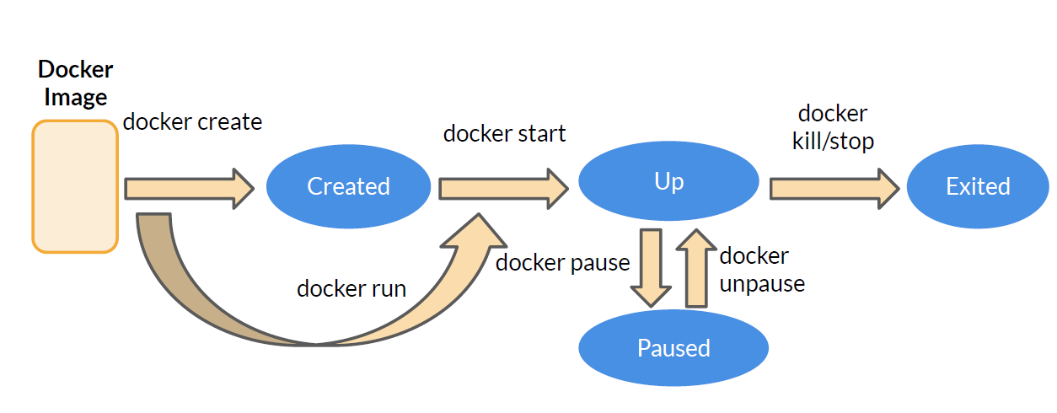
Docker Container Lifecycle

Slide 42
Docker Installation
1

Slide 43
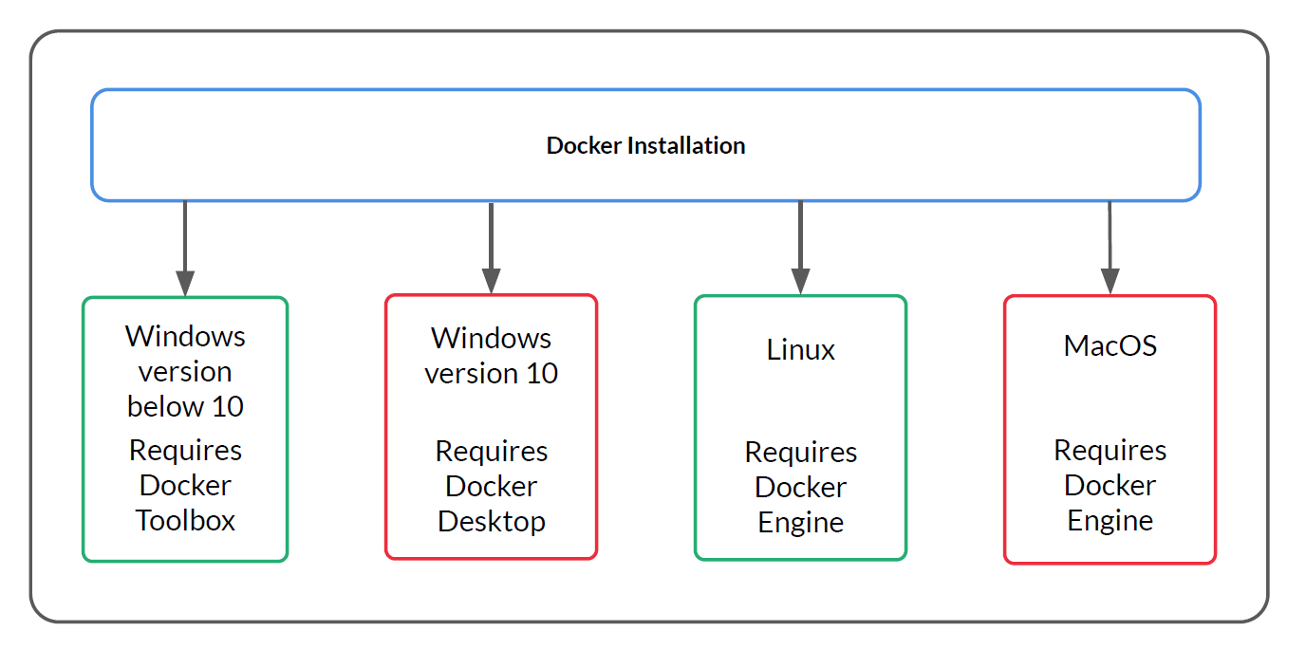
Installing Docker on different Operating Systems
1

Slide 44
Docker for Linux
3
Docker is originally a Linux application
It uses the kernel container functionality
It requires a 64 bit installation using a kernel version 3.10 or later
Docker runs on many popular Linux distributions
It is available as YUM ,RPM, APT, or binary versions

Slide 45
Docker for Mac OS X
4
Docker runs natively on OS X
Is built on the xhyve hypervisor
Requires a 2010 or newer Mac with Intel MMU and EPT support
Requires OS X 10.10.3 Yosemite or newer
Requires at least 4GB of RAM

Slide 46
Docker for Windows
5
Docker runs natively on Windows
Requires later versions of Windows 10 Pro or Enterprise.
Docker requires the Hyper-V package
It virtualizes the Docker environment and Linux kernel specific features

Slide 47
Docker for Windows
5
Docker
Docker
Virtual Box: Linux VM
Docker Application: Windows native virtualization & Hyper-V
Windows
Windows
All Windows prior to Win 10 via
Docker Toolbox
For Windows 10 Professional or Enterprise and above

Slide 48
Overview of Docker Desktop
5
An application for MacOS and Windows machines for the building and sharing of containerized applications and microservices.
Delivers the speed, choice and security for designing and delivering containerized applications on your desktop.
Docker Desktop allows to leverage certified images and templates and choice of languages and tools.
Development workflows leverage Docker Hub to extend development environment to a secure repository for rapid auto-building, continuous integration and secure collaboration.

Slide 49
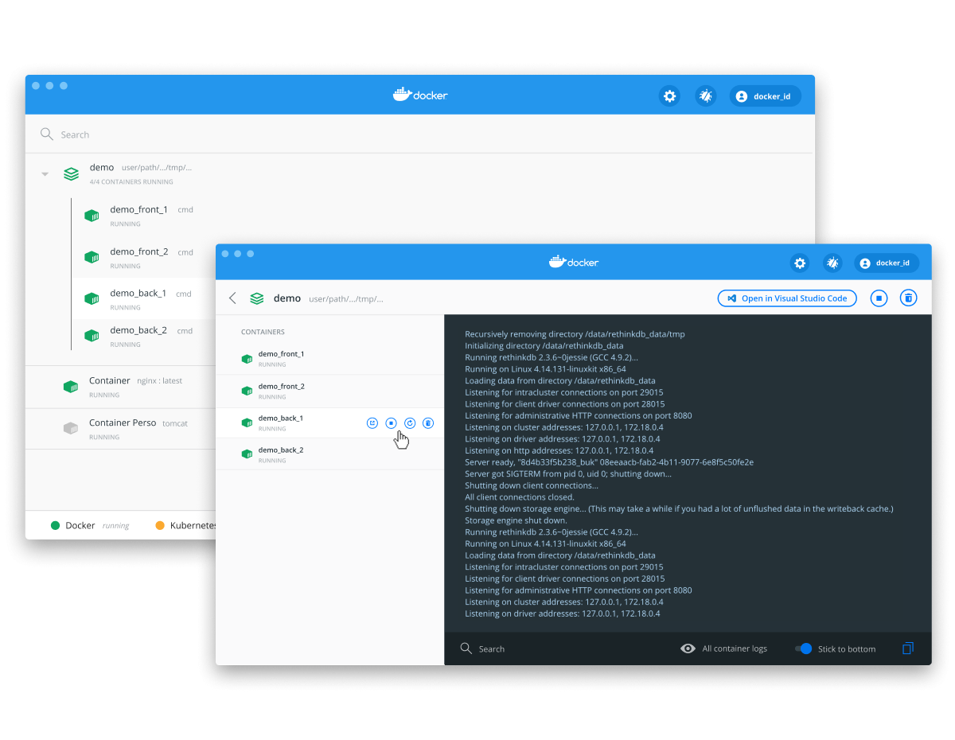
Working with Docker Desktop
5

Slide 50
Docker Registry
1

Slide 51
What is an Image
2
Docker image is a snapshot or template from which new containers can be started. It’s a combination of file system and libraries .
A new image can be created by executing a set of commands contained in a Dockerfile
For example, the below Docker file would take a base Ubuntu image and install git, resulting in a new image:
FROM ubuntu:16.04
RUN apt-get install -y git
Image is composed of a set of read-only layers. Image layers function as follows:
Each image layer is the outcome of one command in the image’s Dockerfile
Each additional image layer only includes the set of differences from the previous layer. (docker history command can be used to check all layer images)

Slide 52
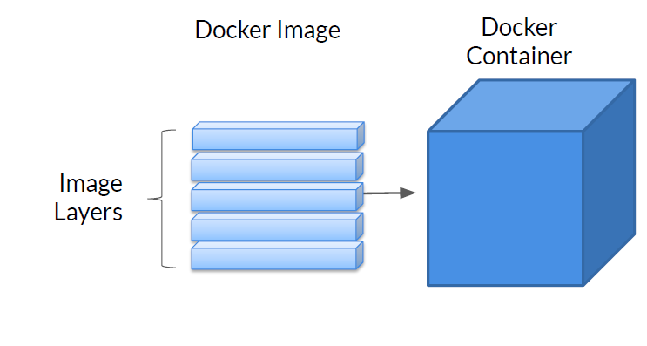
Docker Image Layers

Slide 53
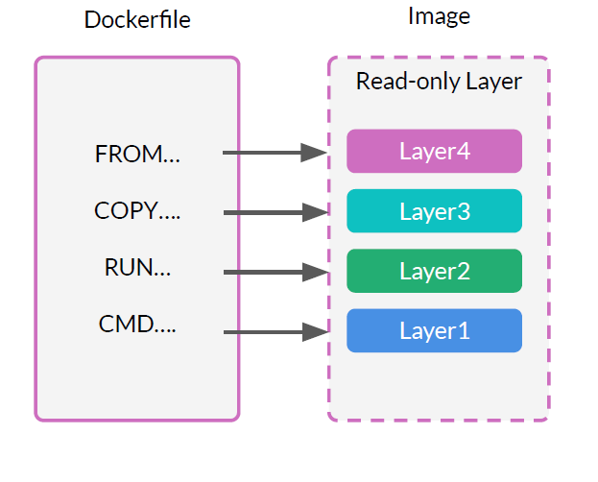
Docker Layers
Docker image is made of a series of Docker layers
Each layer corresponds to an instruction in Dockerfile and is read-only
Each layer contains the differences between the preceding layer and the current layer
Docker images are stored at /var/lib/docker/overlay location on Linux host machine

Slide 54
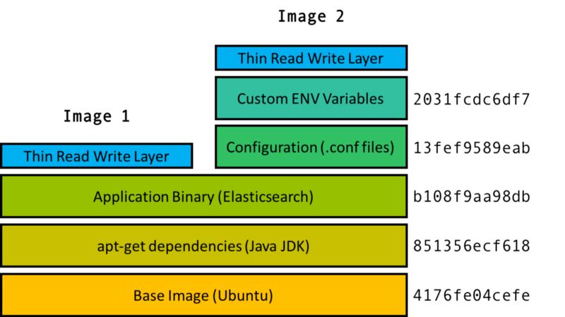
Images and Containers
Container 2
Container 1

Slide 55
Images and Containers
Docker image is an immutable (unchangeable) file or template that contains the source code, libraries, dependencies, tools, and other files needed for an application to run.
These templates are usede as a base to build a container.
Once the container is created, it adds a writable layer on top of the immutable image.
The image-base on which the container exists separately and cannot be altered.
When a containerized environment is run, it creates a read-write copy of that filesystem (docker image) inside the container.

Slide 56
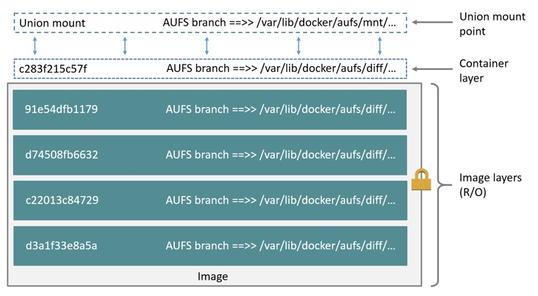
Overlay File System

Slide 57
Overlay File System
OverlayFS is a modern union filesystem which is faster and easy to implement.
Docker provides two storage drivers for OverlayFS: the original overlay, stable overlay2.
OverlayFS layers two directories on a single Linux host and presents them as a single directory. These directories are called layers and the unification process is referred to as a union mount.
OverlayFS refers to the lower directory as lowerdir and the upper directory a upperdir. The unified view is exposed through its own directory called merged.

Slide 58
Docker Registries
5
A Docker registry is a place to store and distribute Docker images. It serves as a target for your docker push and docker pull commands
Repository- Collection of different versions of a single Docker image
Tags – Named version of an image . Provide meaningful name for easy reference
Two types of Registries – Public and Private
Public : Anyone can pull and push images. Eg: Docker Hub , Docker Store
Private : Strict Access control is provided for accessing the images Eg: Google Container Registry, AWS ECR

Slide 59
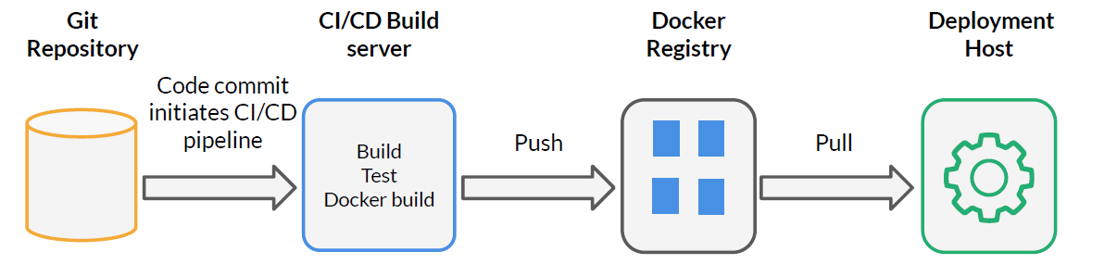
Docker Registry
Can be easily integrated with CI/CD system

Slide 60
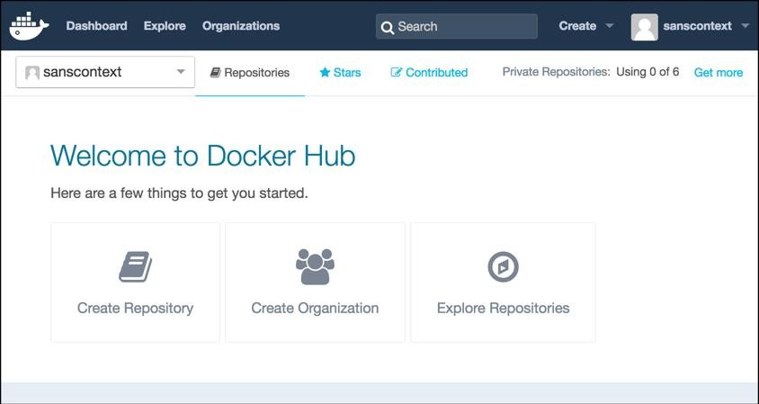
Docker Hub
6
Docker Hub is a cloud-based repository in which Docker users and partners create, test, store and distribute container images.
Users can access public, open source image repositories, as well as use a space to create their own private repositories, automated build functions, and work groups.

Slide 61
Docker Hub-Features
7
Image Repositories: Find and pull images from community and official libraries. Manage, push to, and pull from private image libraries.
Automated Builds: Automatically create new images when any changes are made to a source code repository.
Webhooks: A feature of Automated Builds which triggers actions after a successful push to a repository.
Organizations: Create work groups to manage access to image repositories.

Slide 62
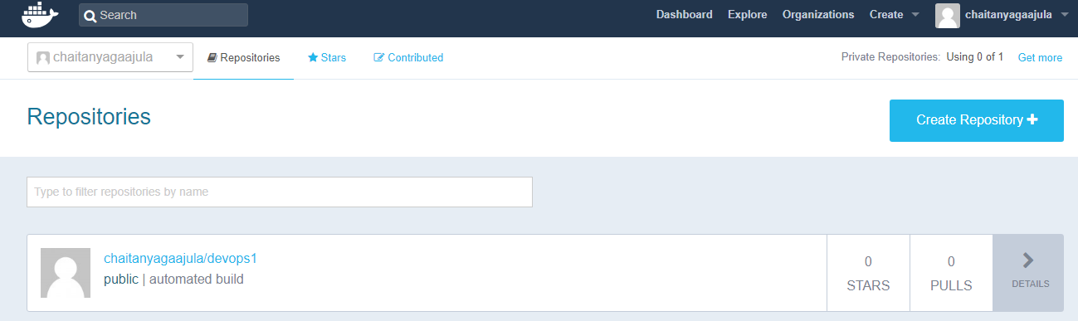
Docker Hub Repository
8
Docker Hub repositories let you share images with co-workers, customers, or the Docker community at large.
Build your own images and push them to a Docker Hub repository .

Slide 63
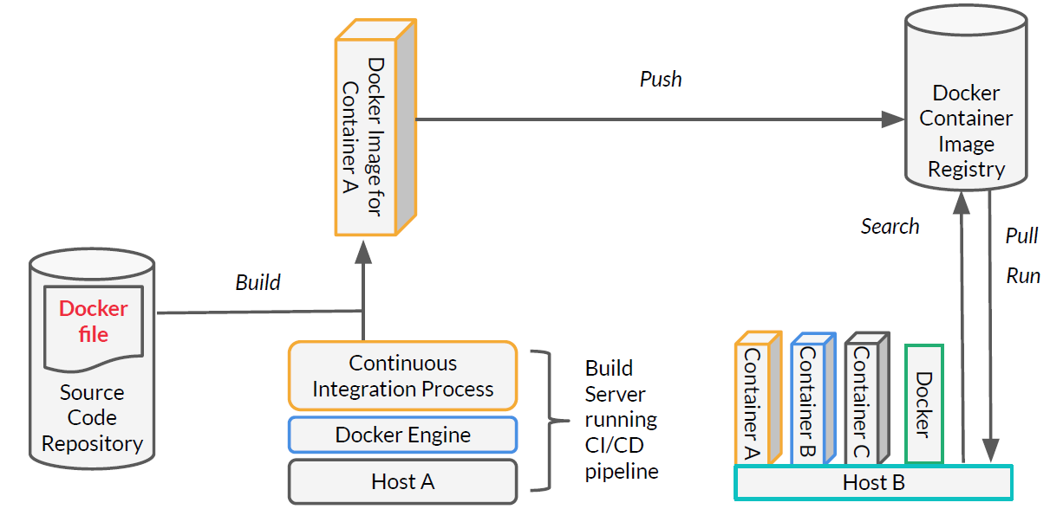
Docker Push / Pull Images

Slide 64
Docker Image Commands
Build / Pull
Create / Download a docker image
Create a container from the image
Save container as image
Upload image to central repository
Stop the container
Delete a container
Run
Commit
Push
Stop
Remove

Slide 65
Thank You

